Slide 1
Incident Investigation
Provided by: Kentucky AGC Self-Insurers' Fund

Slide 2
Today’s Agenda
Why investigate incidents?
Goals of investigations
Immediate causes vs. root causes
Root cause identification
Effective corrective actions
Following up

Slide 3
What Is an Incident?
Injury—An event that caused an employee to be injured.
Near miss—An incident that did not result in an injury, illness or damage but had the potential to.
Property damage—An event that resulted in damage to property.
Occupational illness—An employee becomes ill after being infected with a disease from workplace exposures.

Slide 4
Why Investigate Property Damage and Near Misses?
Often, the only accidents that get investigated are those that require additional information for insurance claims. However, even near misses and property damage should be fully investigated because:
The only difference between an accident and near miss is a factor of luck.
Under slightly different circumstances, a near miss could be a severe accident.
We need to investigate all incidents to identify root causes of issues and to prevent future accidents.

Slide 5
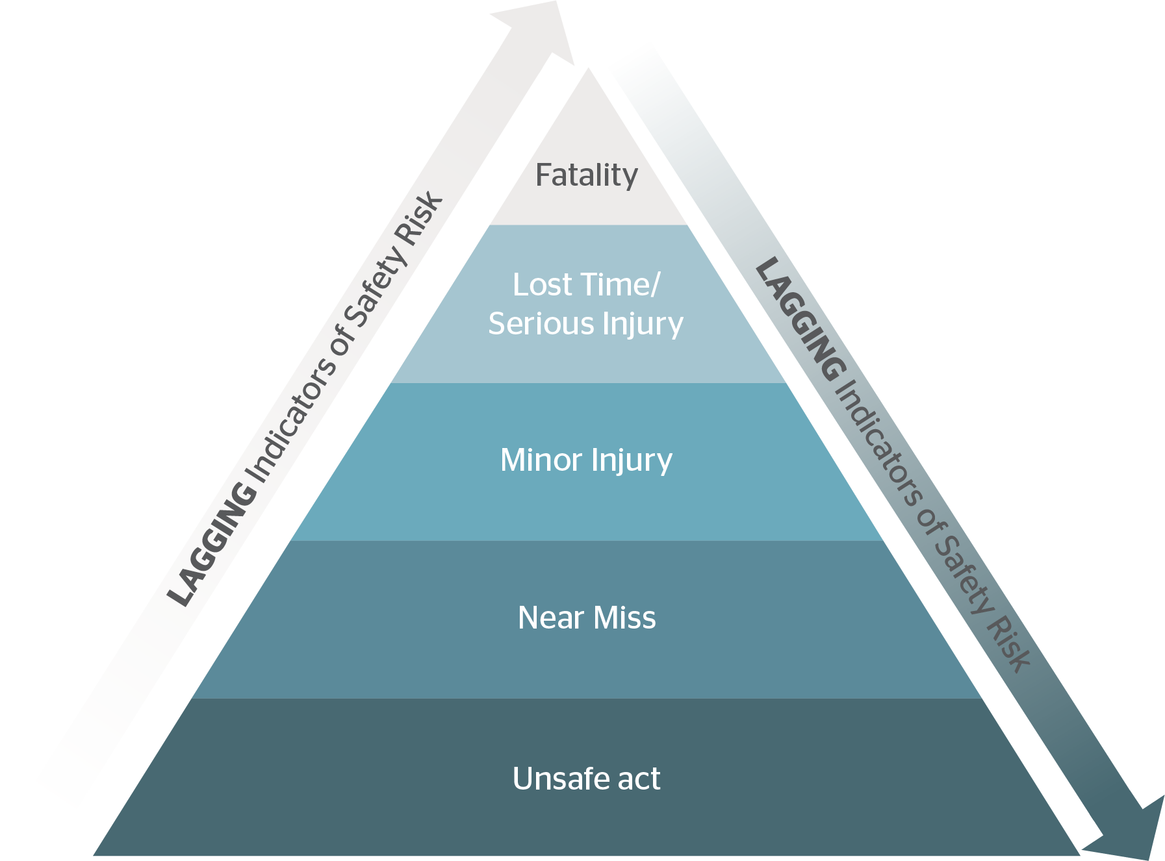
Why Investigate Property Damage and Near Misses?, Cont.
*The focus must be on the bottom of the injury pyramid to prevent the top of the pyramid from happening.

Slide 6
Incident Investigation Goals
Determine the root cause of an incident.
Develop and implement corrective actions to prevent an incident from recurring.
Demonstrate your commitment to the safety of employees.
What would be an employee’s attitude toward safety if we did not care enough to investigate why an incident occurred?
Reduce costs.
The true cost of an accident is far greater than what shows on a loss run.

Slide 7
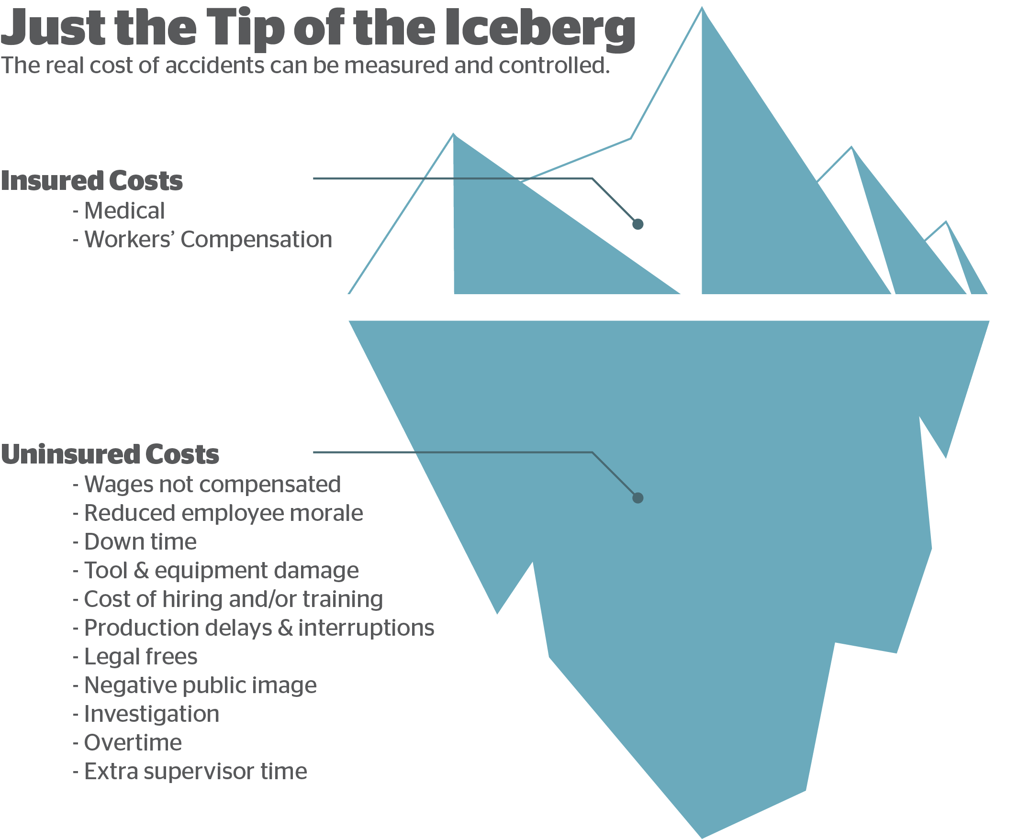
Direct costs are just a small piece of the true cost of an incident.

Slide 8
Who Conducts Investigations?
There’s no perfect answer to this question, but often it’s the immediate supervisor. This is because they:
Know the area, task and employee best
Take ownership of the root cause of the issue
Implement corrective actions
Immediate supervisors may get support from:
Safety committee (reviews corrective action)
Safety manager or coordinator (assists with root cause identification)
Human resources (follows up with the injured employee)
Senior leadership (supports corrective action plans and commits to its implementation)

Slide 9
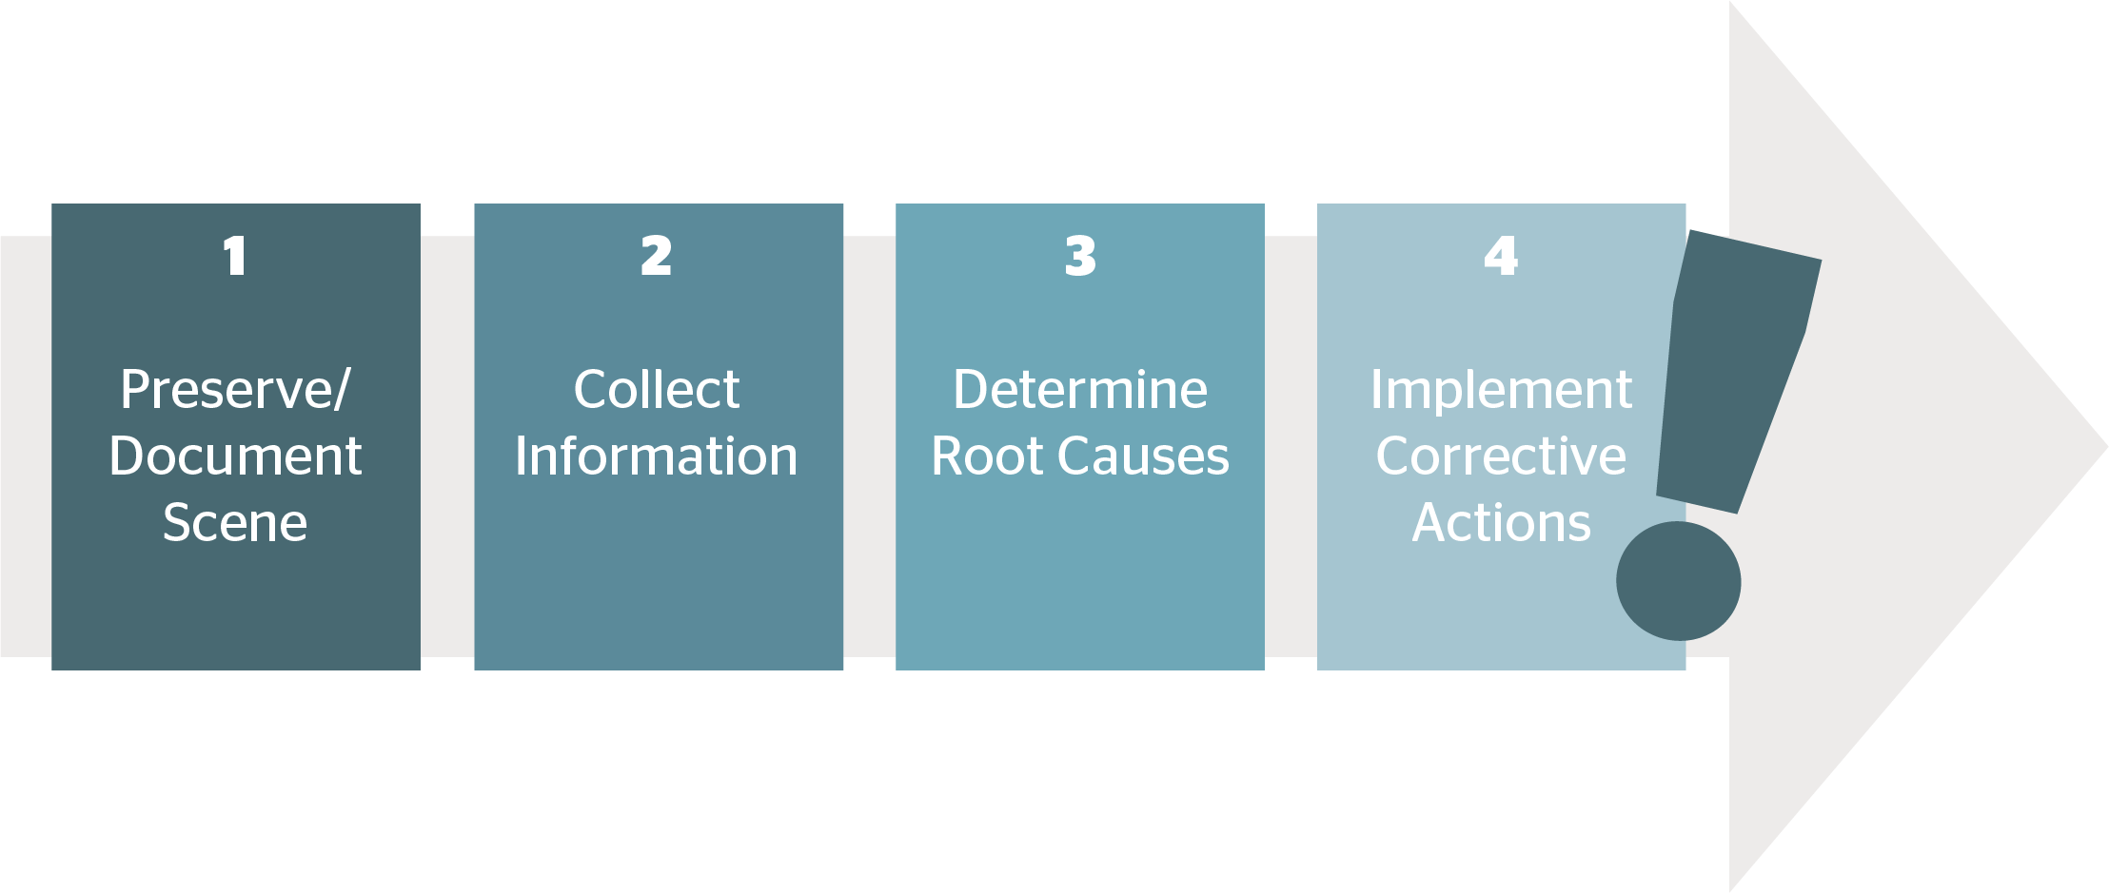
Investigation Process
*Use a systemic approach.

Slide 10
Step 1: Preserve and Document
Before responding to an incident, make sure the employee is taken care of, especially if there is an injury.
Preserve the scene as needed.
This may not be necessary for all incidents.
Taking the time to stop production also sends the message that you take incidents and root cause identification seriously.
Document any relevant information, including:
Witnesses
Equipment readings/condition assessments
Environment conditions
Take photos whenever possible.

Slide 11
Step 2: Collect Information
A major part of collecting information relates to interviewing witnesses. However, you will need to determine who is considered a witness. You will need to think beyond those who directly saw the incident. In general, a witness could be:
Someone who saw the injured person before the incident
Someone who does the same job/task as the injured person
The first person on the scene after an incident
Consider what information you might you gain from a witness.

Slide 12
Step 2: Collect Information, Cont.
Conduct witness interviews as soon as possible (memories and details can fade quickly). When interviewing, keep in mind the following best practices:
State that the purpose of the interview is to determine facts, not fault.
Put the interviewee at ease—do not do anything that might intimidate them.
Ask the interviewee to recount their version of what happened.
Ask open-ended questions (avoid yes or no questions).
Ask clarifying questions, as needed.
Recount the witness statement back to them to ensure clarity.

Slide 13
Step 2: Collect Information, Cont.
Information to gather beyond interviewing witnesses:
Maintenance records
Equipment manuals
Company policies and procedures
Training documentation
Inspections and other follow-up actions
Any other documents relevant to the incident

Slide 14
Step 3: Determine Root Causes
Root causes relate to underlying issues (e.g. why a failure occurred and what led to an incident). This differs from immediate causes, which are simply symptoms of an incident (e.g., the direct, obvious cause of an incident).
Root causes do not focus on behaviors, but are often related to:
Management
Design
Operational failings

Slide 15
Step 3: Determine Root Causes (Example)
Scenario: A forklift being operated with worn brakes crashes into a rack.
Immediate cause is identified as bad brakes, the investigation is declared over and the worn brakes are replaced. Management feels they have addressed the issue.
Will this prevent recurrence?
No. Management has failed to address how the brakes were allowed to get so worn or why employees felt it was OK to keep operating equipment that was not in good working order.
For root causes, you must drill down to the “why.”

Slide 16
Step 3: Determining Root Causes (5 Whys)
5 Whys—A technique to identify root causes
Can help differentiate between immediate causes and root causes
May not necessarily be five whys, but however many are needed

Slide 17
Step 3: Determining Root Causes (5 Whys Example)
Scenario: An employee catches their hand in a moving belt and pulley.
1. Why was his hand caught in a moving belt and pulley?
The guard on the belt and pulley was removed.
2. Why was the guard removed?
The guard was removed to service the machine.
3. Why was the machine still powered with the guard removed?
The machine was not locked out.
4. Why was the machine not locked out?
There is no formal lockout procedure for the machine.
5. Why is there no lockout procedure?
This is a newer machine and no procedure was written when it was bought.
6. Why aren’t there lockout procedures for new equipment?
There is no program for ensuring new equipment is safe, with appropriate procedures and training.

Slide 18
Step 4: Corrective Actions
Corrective actions should be developed to not only prevent the same incident from occurring again, but to also avoid similar incidents in the future.
Too often, corrective actions focus on the injured employee or one specific incident—not what led to led to an incident in the first place.
Get employees who will be affected by the corrective action involved—they know the job and if the action will be effective. Getting their buy-in is critical and ensures the corrective action will be adopted long term.
A common corrective action is to retrain the injured employee. This not an effective corrective action for a number of reasons we will cover in the next slide.

Slide 19
Step 4: Corrective Actions (Example)
Back to our example of the employee getting his hand caught in the belt and pulley …
What if our corrective action was simply: Retrain the injured employee. Why is this likely going to be an ineffective corrective action?
It’s not specific. What is this employee going to be retrained on?
It only affects one employee. How many other employees have similar exposures?
It doesn’t address root causes—just a symptom of the incident.
It focuses on the injured employee and not on preventing future incidents.
Training and retraining is low on the hierarchy of controls.

Slide 20
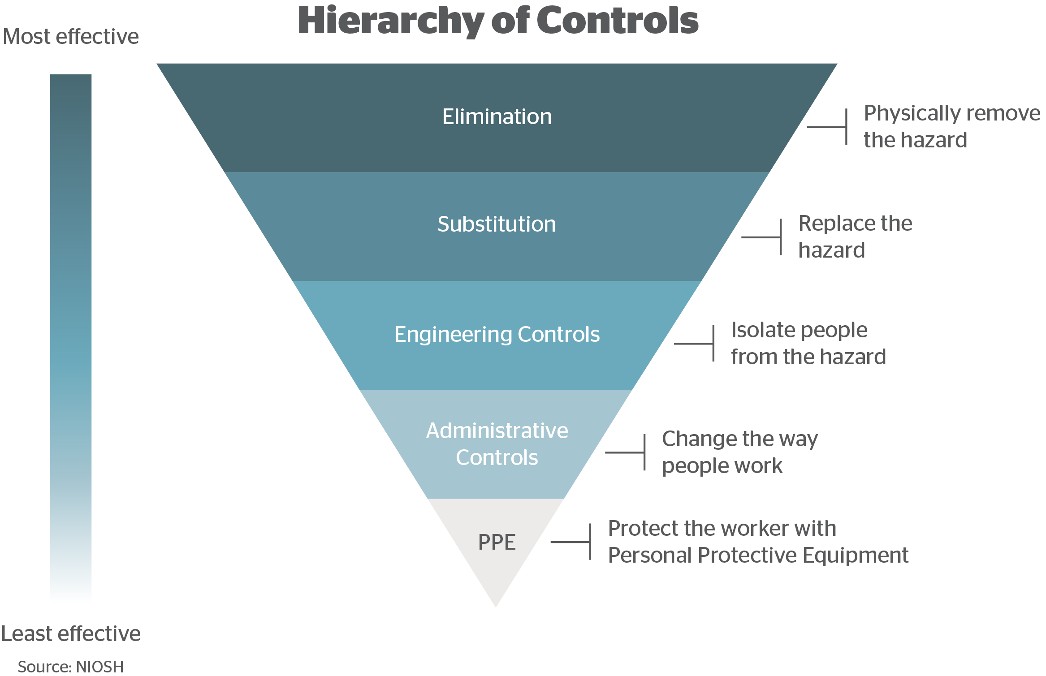
Step 4: Corrective Actions (Hierarchy of Controls)
When looking into corrective actions, start at the top.

Slide 21
Step 4: Corrective Actions, Cont.
Staying with our example of the employee getting his hand caught in the belt and pulley, what might be some more effective corrective actions?
Develop a management of change program. This ensures that, when new equipment is purchased, it meets applicable safety standards. Be sure to train employees on the management of change program.
Audit procedures regularly to ensure all equipment has an up-to-date lockout policy. Train employees on lockout procedures.
Empower employees through training, and encourage them to recognize and report workplace hazards.
Redesign equipment in such a way that guards do not need to be removed during service.

Slide 22
Step 4: Corrective Actions, Cont.
Effective corrective actions:
Reduce risk
Enact a change
Are realistic and achievable
State a specific action that will be taken
State who specifically will be responsible for completing the action
State when the action will be completed by
Are implemented correctly

Slide 23
Root Causes and Corrective Actions
Often, the causes of an incident are not well defined and are left too broad. This hinders organizations from determining the root cause of an issue.
Corrective actions are often too narrow and not broad enough to prevent incident recurrence.
Drill down to the root causes of an incident and develop corrective actions that not only prevent that specific incident from happening again, but prevent similar incidents as well.

Slide 24
Documenting
Incident reports should be completed.
Document all root causes and corresponding corrective actions. Be specific on what actions are to be taken.
Include who will be responsible for completing the corrective actions.
Include the date the corrective action must be complete by. Also include what interim measures will be used to reduce risk until the corrective action will be completed.

Slide 25
Following Up
Develop a formal means of following up on corrective actions. When doing incident investigations for more than just accidents, you may find a number of corrective actions being implemented at once.
Hold those responsible for implementing corrective actions accountable.
After implementation, do not assume the corrective actions were effective:
Look into corrective actions to ensure they were sustainable.
Talk to affected employees, taking their opinion on the corrective actions into account.

Slide 26
Summary of Key Points
All incidents should be investigated.
A near miss is an incident that did not result in an injury, illness or damage but had the potential to—luck prevented more serious harm.
Determine root cause by drilling down.
Corrective actions should prevent future incidents, not just the incident that already occurred.
Follow up to ensure corrective actions are effective.

